Slide 1
ECE 1051 : BASIC ELECTRONICS
SUHAS.K
ASSISTANT PROFESSOR-SENIOR SCALE
DEPARTMENT OF ELECTRONICS & COMMUNICATION ENGINEERING
MIT,MANIPAL

Slide 2
Course Description
Part 1 : Analog Electronics
Diodes and Applications
BJT and Applications
Operational Amplifiers
Part 2: Digital Electronics
Number Systems and Codes
Boolean Algebra
Logic Gates
Flipflops and Applications
Part 3: Principles of Electronic Communication
Analog Communication
Digital Communication
Communication Networks
Mobile Communication

Slide 3
Course Outcomes:
At the end of this course, student will be able to:
CO1: Describe the characteristics of various electronic devices and analyze simple circuit applications using them.
CO2: Describe the working of rectifier, voltage regulator and R-C coupled amplifier.
CO3: Explain the concept of Op-Amp and its basic applications using suitable circuits.
CO4: Simplify Boolean expressions and implement simple digital circuits using logic gates.
CO5: Describe the principles of analog and digital communication.

Slide 4
References
Albert P Malvino, David J Bates – Electronic Principles,7th edition, TMH,2007
Robert L. Boylestad, Louis Nashelsky- Electronic Devices & Circuit Theory, 11th Edition, PHI, 2012
Malvino and Leach- Digital Principles & applications, 7th edition, TMH, 2010.
Morris Mano- Digital design, Prentice Hall of India, Third Edition.
George Kennedy, Bernad Davis- Electronic Communication Systems, 4thedition, TMH, 2004.
Dennis Roddy & John Coolen , "Electronic Communications" ,4th edition, Pearson Education,2009
Garcia and Widjaja, “Communication Networks”, McGraw Hill, 2006
Raj Pandya, “Mobile and Personal Communication Services and Systems”, Wiley-IEEE Press, 1999

Slide 5
Part – I : Analog Electronics
CHAPTER-1: DIODES AND APPLICATONS
Reference:
Robert L. Boylestad, Louis Nashelsky, Electronic Devices & Circuit Theory, 11th Edition, PHI, 2012
Department of Electronics and Communication Engineering, MIT, Manipal

Slide 6
Module – 1 : Diodes
Learning outcomes
At the end of this module, students will be able to:
Explain the operation of PN junction diode under different biasing condition.
Draw the I-V characteristic of diode and differentiate between ideal and practical diodes
Explain the concept of static and dynamic resistance of the diode.
Explain various breakdown phenomenon observed in diodes.
Describe the working of Zener diode and its I-V characteristic.
Department of Electronics and Communication Engineering, MIT, Manipal

Slide 7
Review
Basics of Semiconductors
Doping in Semiconductors
Department of Electronics and Communication Engineering, MIT, Manipal

Slide 8
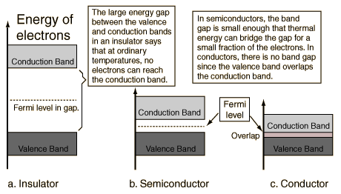
Classification of Materials Based on Energy Band Theory
Department of Electronics and Communication Engineering, MIT, Manipal

Slide 9
Semiconductors
The resistivity of a semiconductor is less than that of an insulator but more than that of a conductor
A semiconductor has negative temperature co-efficient of resistance
Conducting properties change appreciably by adding suitable impurities (e.g.,Arsenic,Gallium etc.,)-Doping

Slide 10
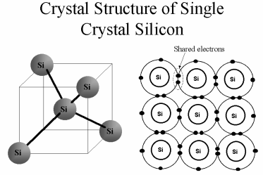
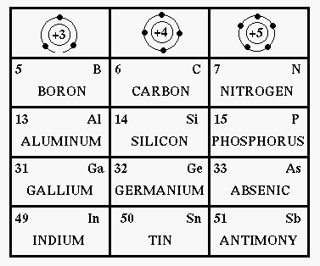
Semiconductor Materials
Crystal structure of silicon
Semiconducting materials
Common Semiconducting materials : Ge, Si, GaAs
Department of Electronics and Communication Engineering, MIT, Manipal
Notes:
A semiconductor is a material which has electrical conductivity between that of a conductor such as copper and that of an insulator such as glass. Semiconductors are the foundation of modern electronics, including transistors, solar cells, light-emitting diodes (LEDs), quantum dots and digital and analog integrated circuits.
Mostly used semiconductor material is silicon. It consists of silicon in which the crystal lattice of the entire solid is continuous, unbroken (with no grain boundaries) to its edges. Silicon atomic core is surrounded by four valence electrons.

Slide 11
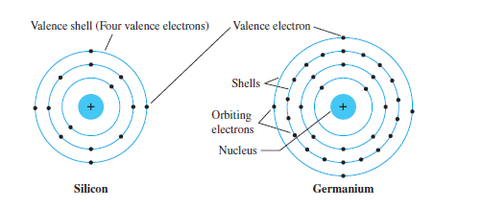
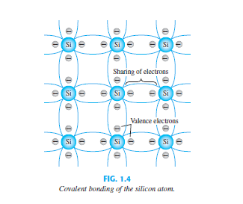
Structure of Semiconductor Material

Slide 12
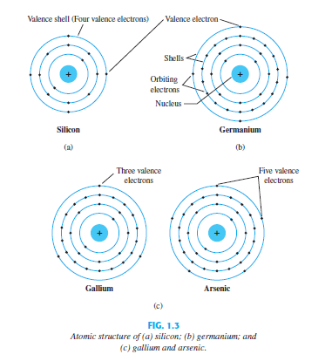
Semiconductor Materials
Single-crystal
Silicon(14)
Germanium (32)
Compound
Gallium Arsenide

Slide 13
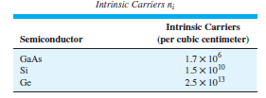
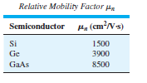
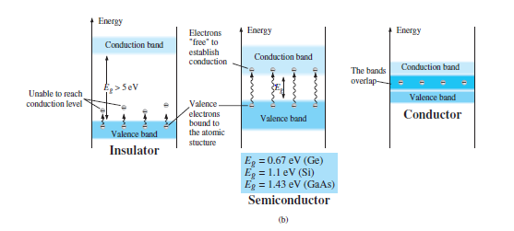
Semiconductor Materials

Slide 14
Intrinsic & Extrinsic Semiconductors
Intrinsic Semiconductors
Semiconductors in pure form are intrinsic
Free electrons are due to external causes (voltage/ temperature)
Extrinsic Semiconductors
Subjected to doping
Adding pentavalent impurity results n-type
Adding trivalent impurity results p-type

Slide 15
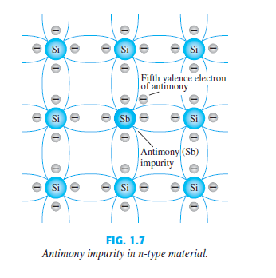
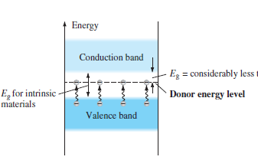
n-type Semiconductor
Pentavalent impurities (antimony, arsenic, phosphorous etc.) are added
Electrons are majority carriers

Slide 16
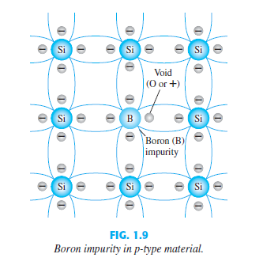
P-type semiconductor
Trivalent impurities (Boron, gallium, indium etc.) are added
Holes are majority carriers

Slide 17
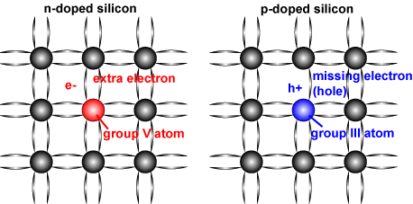
Doping in Semiconductors
Schematic of a silicon crystal lattice doped with impurities to produce n-type and p-type semiconductor material.
Department of Electronics and Communication Engineering, MIT, Manipal
Notes:
N-type semiconductor:
When a small amount of pentavalent donor atoms (e.g., phosphorus (P) and Arsenic (As)) is added, a silicon atom in the lattice may be replaced by a donor atom with four of its valence electrons forming the covalent bounds and one extra free electron. This is an N-type semiconductor.
P-type semiconductor:
When a small amount of trivalent acceptor atoms (e.g., boron (B) and aluminum (Al)) is added, a silicon atom in the lattice may be replaced by an acceptor atom with only three valence electrons forming three covalent bounds and a hole in the lattice. This is a P-type semiconductor.

Slide 18
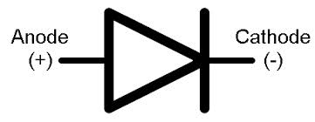
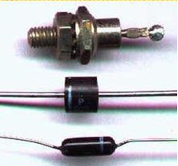
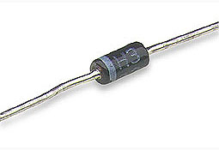
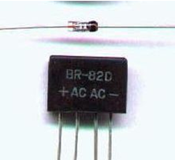
P-N Junction Diode
Anode
P
N
Cathode
Common practical diodes available in market
Department of Electronics and Communication Engineering, MIT, Manipal
Notes:
P-N Junction diode: is a 2-terminal, 2-layer, single-junction semiconductor device made out of a single block of silicon or germanium, with one side doped with acceptor (p-type) impurity and the other side with donor (n-type) impurity. Numerous applications are like Switch, Rectifier, Regulator, Voltage multiplier, Clipping, Clamping, etc.
Construction:
The two terminals are called Anode and Cathode
1.At the instant the two materials are “joined”, electrons and holes near the junction cross over and combine with each other
2.Holes cross from P-side to N-side
3.Free electrons cross from N-side to P-side
4.At P-side of junction, negative ions are formed
5.At N-side of junction, positive ions are formed

Slide 19
P-N Junction Diode
Used in numerous applications
Switch
Rectifier
Regulator
Voltage multiplier
Clipping
Clamping, etc.

Slide 20
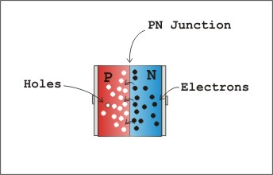
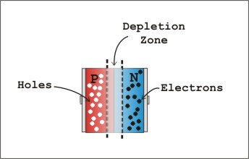
P-N Junction Diode under biasing
P-N junction (a) in contact (b) formation of depletion region
Notes:
Notes:
A PN junction have
- A P-type and N-type region
- Depletion region - region having no free carriers
Further movement of electrons and holes across the junction stops due to formation of depletion region
- Depletion region acts as barrier opposing further diffusion of charge carriers. So diffusion stops within no time
- Current through the diode under no-bias condition is zero Bias.

Slide 21
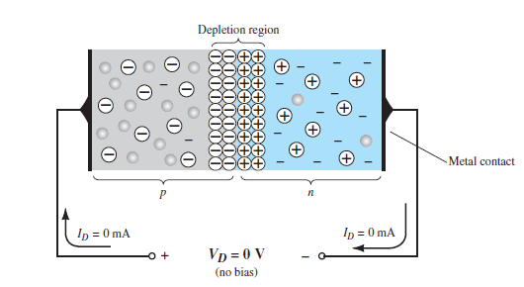
P-N Junction Diode
Unbiased condition
Notes:
In the absence of an applied bias voltage, the net flow of charge in any one direction for a semiconductor diode is zero. This occurs because any minority carriers (holes) in the n-type material that find themselves within the depletion region will pass directly into the p-type material. The same happens with due to the electrons in the depletion region that will pass to the n-type material. The result is a depletion region empty of charge carriers, with high impedance, so no net current passes through the diode. This results in development of built-in potential ranging from 0.3-0.7 eV depending upon the type semiconducting material used.

Slide 22
Initially when the junction is formed, density of free electrons in n region and holes in the p region is very huge.
Because of density gradient, charge carriers diffuse through the junction and recombine.
This gives rise to recombination current.
Recombination decays exponentially w.r.t time and distance from the junction.
Every time a free electron diffuse through the junction and recombine with a hole, it creates a pair of positive and negative ions(Dipole)
As the number of dipoles build up, the region near the junction is emptied/depleted of charge carriers. Depletion region/ Space charge region

Slide 23
Width of the depletion region depends on the doping level
Higher the doping level, smaller is the width.
Reason: Diffusing charge carrier need not travel far across the junction in order to recombine.
Ions within the depletion region produce an electric field “E”. This represents potential difference between the two regions. Barrier Potential

Slide 24
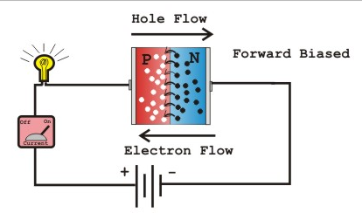
Forward bias
Positive of battery connected to p-type (anode)
Negative of battery connected to n-type (cathode)
Diode under forward biasing conditions
Notes:
Forward biasing:
When forward biasing is applied
-Electrons in n-type are forced to recombine with positive ions near the boundary, similarly holes in p-type are forced to recombine with negative ions
-Depletion region width reduces
-An electron in n-region “sees” a reduced barrier at the junction and strong attraction for positive potential
-As forward bias is increased, depletion region narrows down and finally disappears – leads to exponential rise in current
- Forward current is measured in milli amperes

Slide 25
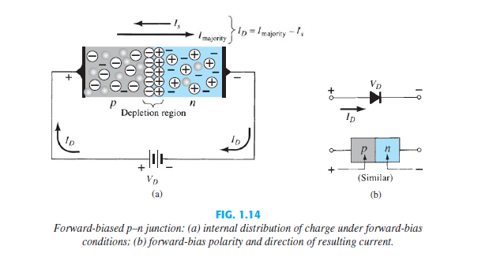
Forward Bias

Slide 26
Battery pushes the free electrons and holes towards the junction
As long as applied voltage is less than the barrier potential, free electrons do not have the energy to pass through the depletion region.
When electrons try to enter the depletion region, negative ions push them back.
When the applied voltage is more than barrier potential, free electrons pass through the junction
Current flows in the diode as long as applied voltage is more than barrier potential.
Width of the depletion region reduces during forward biasing

Slide 27
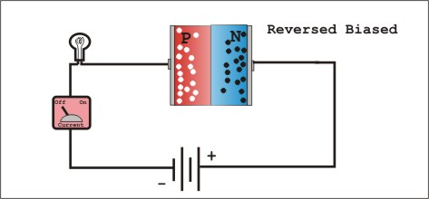
Reverse bias
Positive of battery connected to n-type material (cathode)
Negative of battery connected to p-type material (anode)
Diode under reverse biasing conditions
Notes:
Reverse biasing:
When reverse bias is applied
-Free electrons in n-region are drawn towards positive of battery, Holes in p-region are drawn towards negative of battery
-Depletion region widens, barrier increases for the flow of majority carriers
-Majority charge carrier flow reduces to zero
-Minority charge carriers generated thermally can cross the junction – results in a current called “reverse saturation current”.

Slide 28
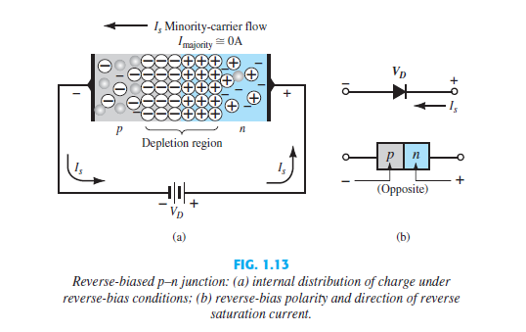
Reverse bias

Slide 29
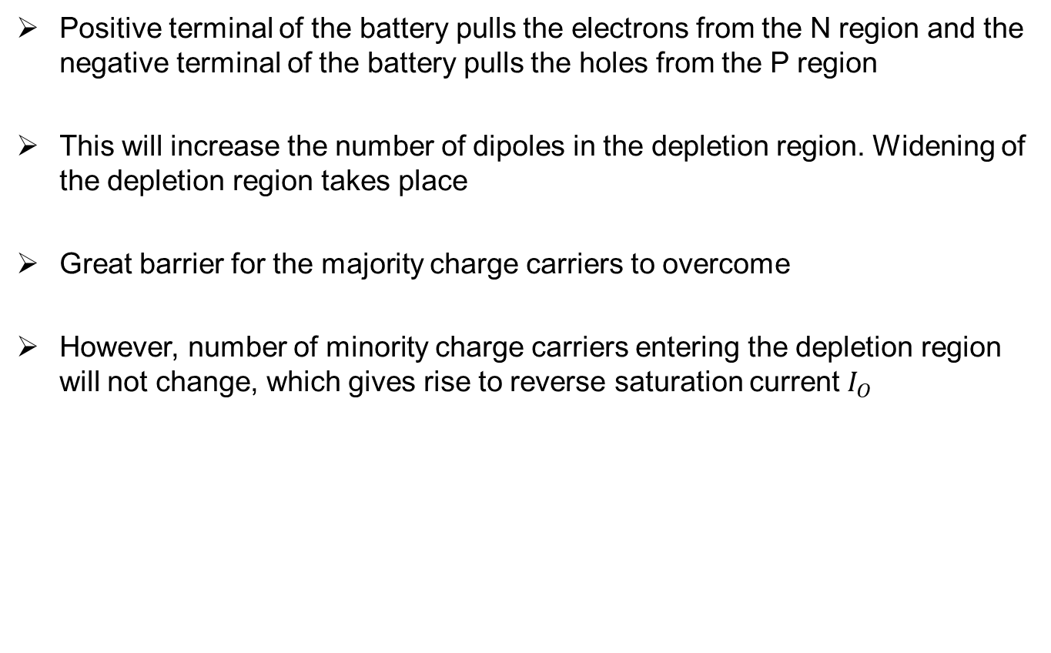
Positive terminal of the battery pulls the electrons from the N region and the negative terminal of the battery pulls the holes from the P region
This will increase the number of dipoles in the depletion region. Widening of the depletion region takes place
Great barrier for the majority charge carriers to overcome
However, number of minority charge carriers entering the depletion region will not change, which gives rise to reverse saturation current $I_{O}$

Slide 30
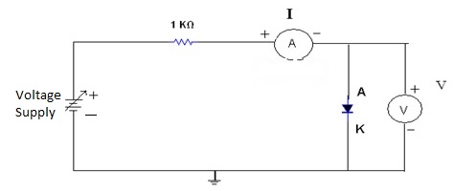
I-V characteristic of practical diode
X axis: Voltage across the diode
Y axis: Current through the diode

Slide 31
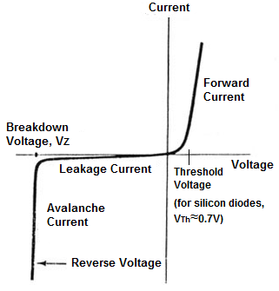
I-V characteristic of practical diode
(mA)
Diode symbol
P
N
V_{γ} is 0.6 ~ 0.7 Vfor Si
0.2 ~ 0.3 V for Ge
(μA)
I-V characteristic of Practical diode
Notes:
I-V characteristics:
I-V characteristics of the practical diode. The forward current is in the range of milli amperes when forward biased. When the diode is reverse biased only reverse saturation current flows which is in the range of few micro amperes.

Slide 32
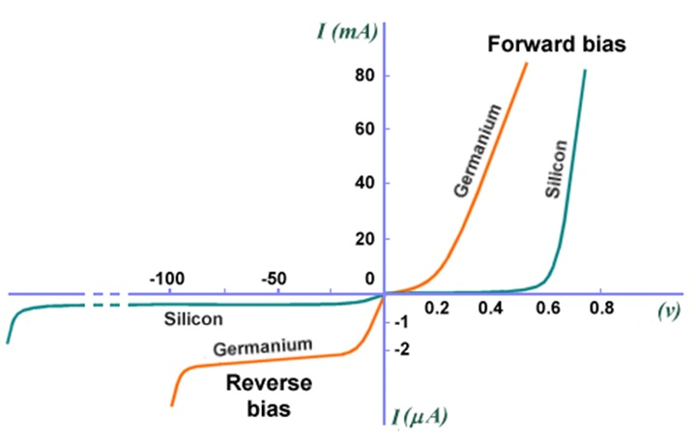
Silicon vs. Germanium
I-V characteristic of silicon and germanium practical diode
http://www.technologyuk.net/physics/electrical_principles/the_diode.shtml

Slide 33
Diode current equation
I_{D} is diode current
I_{o} is reverse saturation current
V_{D} is applied bias voltage(positive for forward bias, negative for reverse bias)
V_{T} is thermal voltage = T / 11600
η is a constant ;1 for Ge and 2 for Si
For positive values of V_{D} (forward bias),
For large negative values of V_{D} (reverse bias), I_{D} ≈ –I_{o}

Slide 34
Effect of Temperature on the Diode current
Reverse current doubles for every 10 degree rise in temperature.
Forward cut-in voltage changes -2.5mV/0C increase in temparature

Slide 35
Effect of Temperature on the Reverse current
I (mA)
–75ºC
125ºC
25ºC
V (volts)
I (μA)

Slide 36
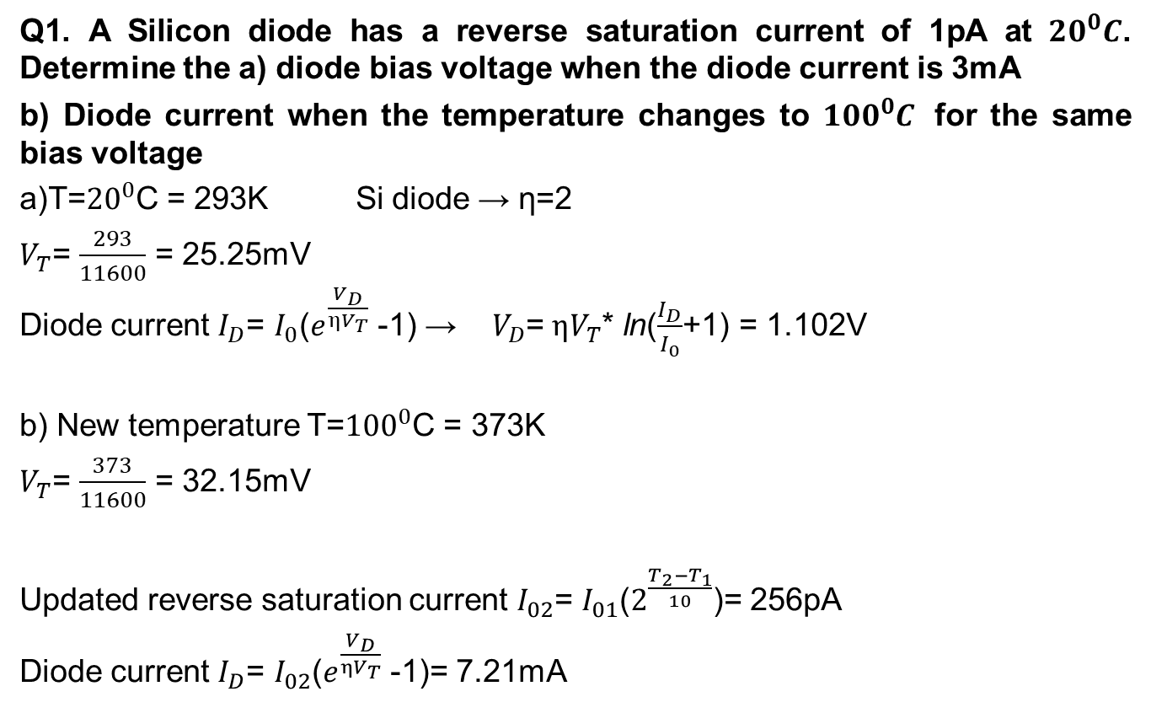
Example
Q1. A Silicon diode has a reverse saturation current of 1pA at ${20}^{0}C$. Determine the a) diode bias voltage when the diode current is 3mA
b) Diode current when the temperature changes to ${100}^{0}C$ for the same bias voltage
a)T=${20}^{0}$C = 293K Si diode → η=2
$V_{T}$= $\frac{293}{11600}$ = 25.25mV
Diode current $I_{D}$= $I_{0}$($e^{\frac{V_{D}}{ηV_{T}}}$ -1) → $V_{D}$= $ηV_{T}$* ln($\frac{I_{D}}{I_{0}}$+1) = 1.102V
b) New temperature T=${100}^{0}$C = 373K
$V_{T}$= $\frac{373}{11600}$ = 32.15mV
Updated reverse saturation current $I_{02}$= $I_{01}$($2^{\frac{T_{2}−T_{1}}{10}}$)= 256pA
Diode current $I_{D}$= $I_{02}$($e^{\frac{V_{D}}{ηV_{T}}}$ -1)= 7.21mA

Slide 37
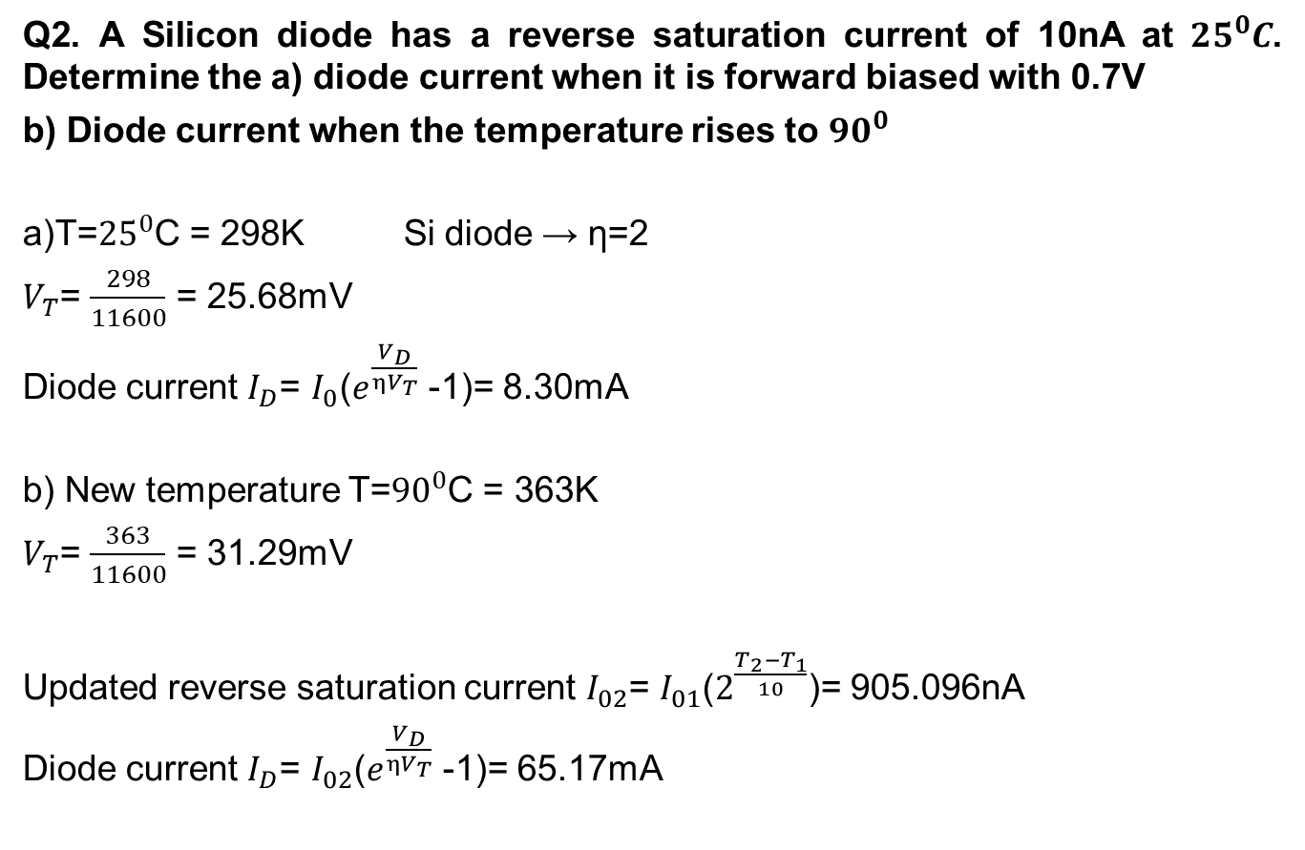
Example
Q2. A Silicon diode has a reverse saturation current of 10nA at ${25}^{0}C$. Determine the a) diode current when it is forward biased with 0.7V
b) Diode current when the temperature rises to ${90}^{0}$
a)T=${25}^{0}$C = 298K Si diode → η=2
$V_{T}$= $\frac{298}{11600}$ = 25.68mV
Diode current $I_{D}$= $I_{0}$($e^{\frac{V_{D}}{ηV_{T}}}$ -1)= 8.30mA
b) New temperature T=${90}^{0}$C = 363K
$V_{T}$= $\frac{363}{11600}$ = 31.29mV
Updated reverse saturation current $I_{02}$= $I_{01}$($2^{\frac{T_{2}−T_{1}}{10}}$)= 905.096nA
Diode current $I_{D}$= $I_{02}$($e^{\frac{V_{D}}{ηV_{T}}}$ -1)= 65.17mA

Slide 38
Diode resistances
Static or DC resistance:
Ratio of diode voltage and diode current
Lower the current through the diode, higher the DC resistance level
The dc resistance at the knee and below will be greater than the resistance at the linear section of characteristic
The dc resistance in the reverse bias region will naturally be quite high
Notes:
DC resistance:
-The dc resistance at the knee and below will be greater than the resistance at the linear section of characteristics.
-The dc resistance in the reverse bias region will naturally be quite high.
Dynamic or AC resistance
-Often sinusoidal voltages are applied to diode
-So the instantaneous operating point moves up and down in the characteristic curve
-So DC resistance is not a suitable parameter
-Instead, AC resistance is used
-It is the change in the diode voltage divided by the corresponding change in the diode current, where the change is as small as possible.
-Dynamic resistance can be found using previous equation, no need of characteristic curve
-Dynamic resistance in reverse region is very high, since slope of characteristic curve is almost zero
-The resistance calculated using equation does not include the resistance due to the metal contact (usually less than 0.1 Ω).

Slide 39
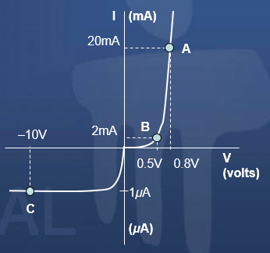
Diode resistances
Determine the dc resistances at the three different operating points A, B and C.

Slide 40
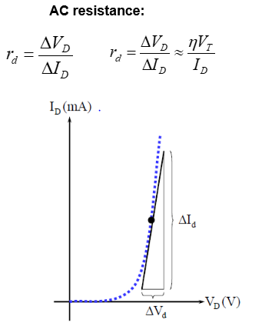
Diode resistances
Dynamic or AC resistance
When input is ac (varying)
It is the change in the diode voltage divided by the corresponding change in the diode current, where the change is as small as possible

Slide 41
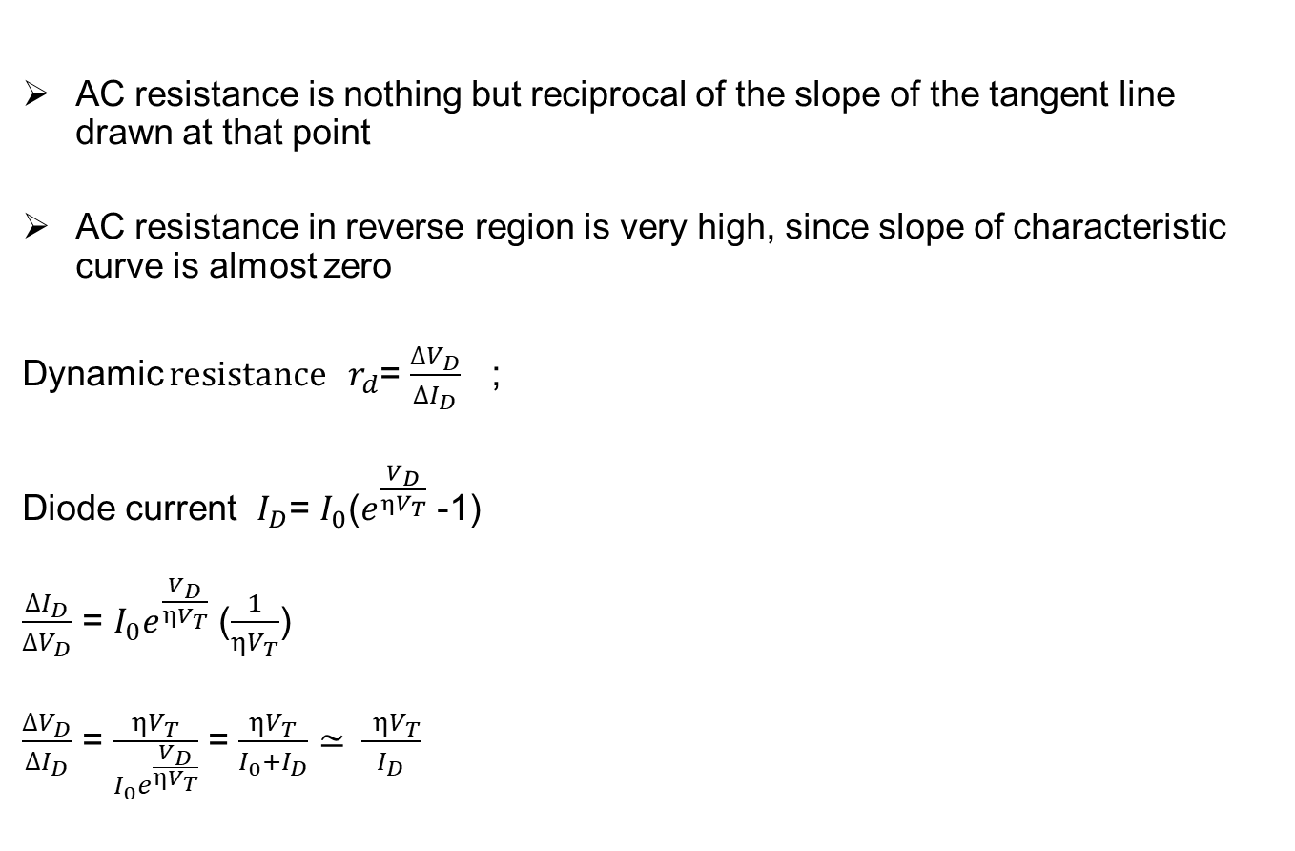
Diode resistances
AC resistance is nothing but reciprocal of the slope of the tangent line drawn at that point
AC resistance in reverse region is very high, since slope of characteristic curve is almost zero
Dynamic resistance $r_{d}$= $\frac{ΔV_{D}}{ΔI_{D}}$ ;
Diode current $I_{D}$= $I_{0}$($e^{\frac{V_{D}}{ηV_{T}}}$ -1)
$\frac{ΔI_{D}}{ΔV_{D}}$ = $I_{0}e^{\frac{V_{D}}{ηV_{T}}}$ ($\frac{1}{ηV_{T}}$)
$\frac{ΔV_{D}}{ΔI_{D}}$ = $\frac{ηV_{T}}{I_{0}e^{\frac{V_{D}}{ηV_{T}}}}$ = $\frac{ηV_{T}}{I_{0}+I_{D}}$ ≃ $\frac{ ηV_{T}}{I_{D}}$

Slide 42
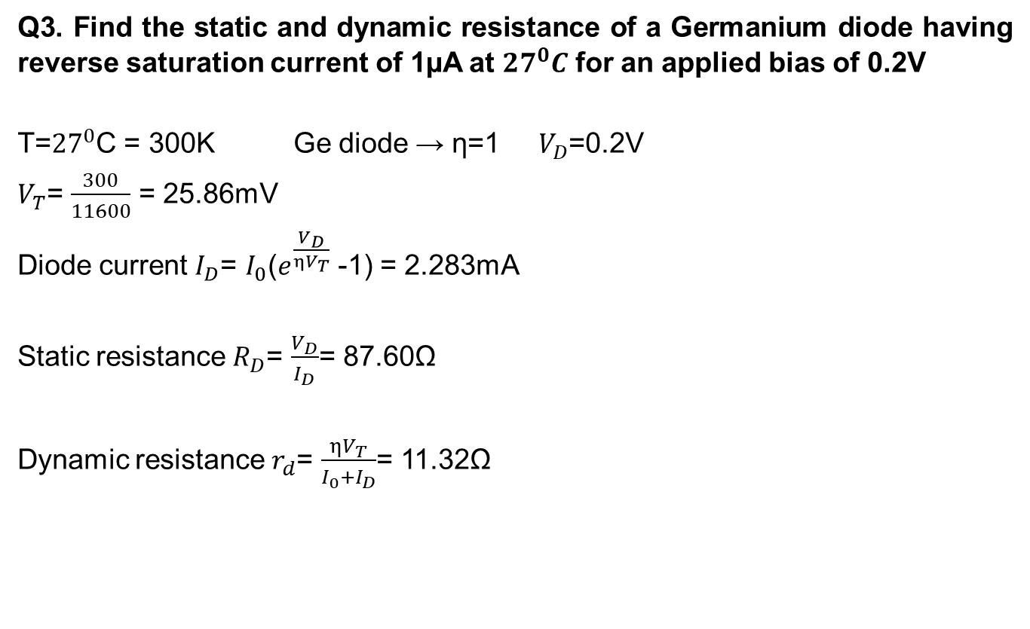
Example
Q3. Find the static and dynamic resistance of a Germanium diode having reverse saturation current of 1µA at ${27}^{0}C$ for an applied bias of 0.2V
T=${27}^{0}$C = 300K Ge diode → η=1 $V_{D}$=0.2V
$V_{T}$= $\frac{300}{11600}$ = 25.86mV
Diode current $I_{D}$= $I_{0}$($e^{\frac{V_{D}}{ηV_{T}}}$ -1) = 2.283mA
Static resistance $R_{D}$= $\frac{V_{D}}{I_{D}}$= 87.60Ω
Dynamic resistance $r_{d}$= $\frac{ηV_{T}}{I_{0}+I_{D}}$= 11.32Ω

Slide 43
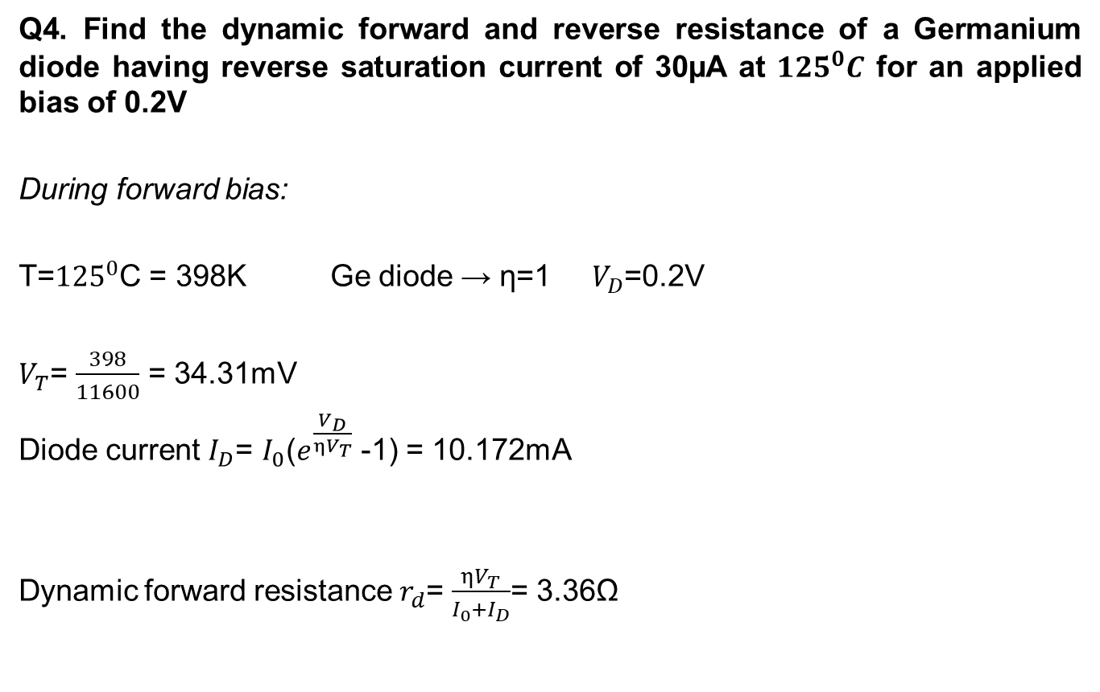
Example
Q4. Find the dynamic forward and reverse resistance of a Germanium diode having reverse saturation current of 30µA at ${125}^{0}C$ for an applied bias of 0.2V
During forward bias:
T=${125}^{0}$C = 398K Ge diode → η=1 $V_{D}$=0.2V
$V_{T}$= $\frac{398}{11600}$ = 34.31mV
Diode current $I_{D}$= $I_{0}$($e^{\frac{V_{D}}{ηV_{T}}}$ -1) = 10.172mA
Dynamic forward resistance $r_{d}$= $\frac{ηV_{T}}{I_{0}+I_{D}}$= 3.36Ω

Slide 44

During reverse bias:
T=${125}^{0}$C = 398K Ge diode → η=1 $V_{D}$= -0.2V
$V_{T}$= $\frac{398}{11600}$ = 34.31mV
Diode current $I_{D}$= $I_{0}$($e^{\frac{V_{D}}{ηV_{T}}}$ -1) = -29.911$µ$A
Dynamic reverse resistance $r_{d}$= $\frac{ηV_{T}}{I_{0}+I_{D}}$= 385kΩ

Slide 45
Ideal Diode
Cut-in voltage is zero
No barrier potential. Small forward bias voltage causes conduction through the device
Forward resistance is zero
Reverse resistance is infinity
Conducts when forward biased and blocks conduction when reverse biased. Hence reverse saturation current is zero

Slide 46
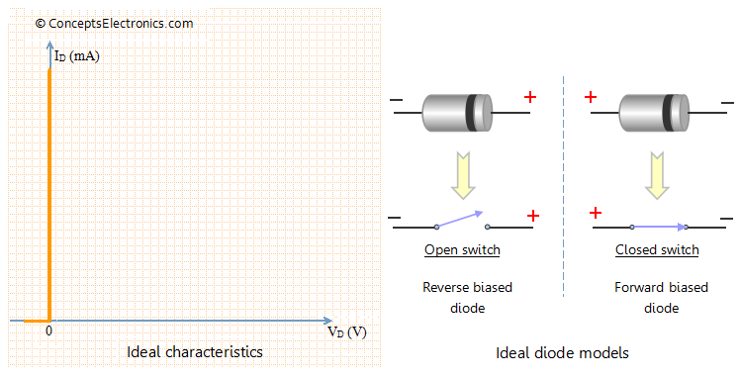
Ideal diode : I-V characteristics
I-V characteristic of Ideal diode and ideal models
Notes:
Ideal Diode:
An ideal diode is simply a pn junction where the change from p-type to n-type material is assumed to occur instantaneously, also referred to as an abrupt junction. The simplified diode model ignores the effect of diode resistance in comparison with values of other elements of the circuit. The voltage drop across the diode (0.7 V for Si) is negligible. Hence the diode voltage drop can be ignored for simplification purpose.

Slide 47
Practical Diode
For conduction, the barrier potential has to be overcome
Forward resistance is in the range of tens of ohms
Reverse resistance is in range of mega ohms
Does not conduct when reverse biased. However there is reverse saturation current flowing through the device

Slide 48
Diode Equivalent Circuit
Used during circuit analysis
Characteristic curve replaced by straight-line segments
A
K
1/R_{F}
A
K
Forward bias
R_{F}
R_{R} = ∞
Vγ
A
K
Reverse bias
Vγ

Slide 49
Diode Equivalent Circuit
As further approximation, we can neglect the slope of the characteristic i.e., R_{F} = 0
A
K
R_{F} = 0
A
K
Forward bias
R_{R} = ∞
Vγ
A
K
Reverse bias
Vγ

Slide 50
Diode Equivalent Circuit
As third approximation, even the cut-in voltage can be neglected (Ideal diode)
A
K
R_{F} = 0
A
K
Forward bias
R_{R} = ∞
Vγ = 0
A
K
Reverse bias

Slide 51
Breakdown phenomenon in diodes
If the reverse bias across the diode is increased beyond certain level, breakdown occurs.
Reverse current rises abruptly which will spoil the diode
Two breakdown mechanisms:
Avalanche breakdown
Zener Breakdown
Notes:
Break down phenomenon in diodes:
Breakdown voltage is a parameter of a diode that defines the largest reverse voltage that can be applied without causing an exponential increase in the current in the diode. As long as the current is limited, exceeding the breakdown voltage of a diode does no harm to the diode.
Zener breakdown can be reversible (zener breakdown) and irreversible (avalanche breakdown) .
There are two breakdown mechanisms exist in diode.They are
-Zener breakdown
-Avalanche breakdown

Slide 52
Avalanche breakdown :
Occurs in Lightly doped diodes,
Occurs at high reverse Voltage.
Due to velocity of the minority charge carriers

Slide 53
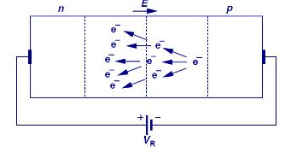
Avalanche Breakdown
Schematic of Avalanche phenomenon
Notes:
Avalanche breakdown occurs when the applied voltage is so large that electrons that are pulled from their covalent bonds are accelerated to great velocities. These electrons collide with the silicon atoms and knock off more electrons. These electrons are then also accelerated and subsequently collide with other atoms. Each collision produces more electrons which leads to more collisions .The current in the semiconductor rapidly increases and the material can quickly be destroyed.Avalanche breakdown is observed for reverse bias voltages above 6V.

Slide 54
Zener Breakdown:
Occurs in heavily doped diodes.
at lower reverse bias voltages.
Due to strong E field in the depletion region

Slide 55
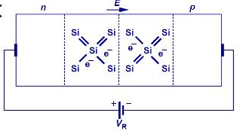
Zener Breakdown
Schematic of Zener phenomenon
Notes:
In Zener breakdown the electrostatic attraction between the negative electrons and a large positive voltage is so great that it pulls electrons out of their covalent bonds and away from their parent atoms. Electrons are transferred from the valence to the conduction band. In this situation, the current can still be limited by the limited number of free electrons produced by the applied voltage so it is possible to cause Zener breakdown without damaging the semiconductor.This breakdown is observed for reverse bias voltages below 4V.

Slide 56
Exercises
Q5. A silicon diode is reverse biased with 5V at room temperature. if reverse sat current is 60pA, what is the diode current?
Q6. A germanium diode carries a current of 10mA when it is forward biased with
0.2V at 27ºC. (a) Find reverse sat current. (b) Find the bias voltage
required to get a current of 100mA
Q7. Calculate the factor by which reverse saturation current of silicon diode is multiplied when the temperature increases from 25 to 100^{O}C.
Q8. A Si diode operates at forward voltage of 0.4V. Calculate the factor by which the current will be changed when the temperature increased from at 25ºC to 150ºC

Slide 57
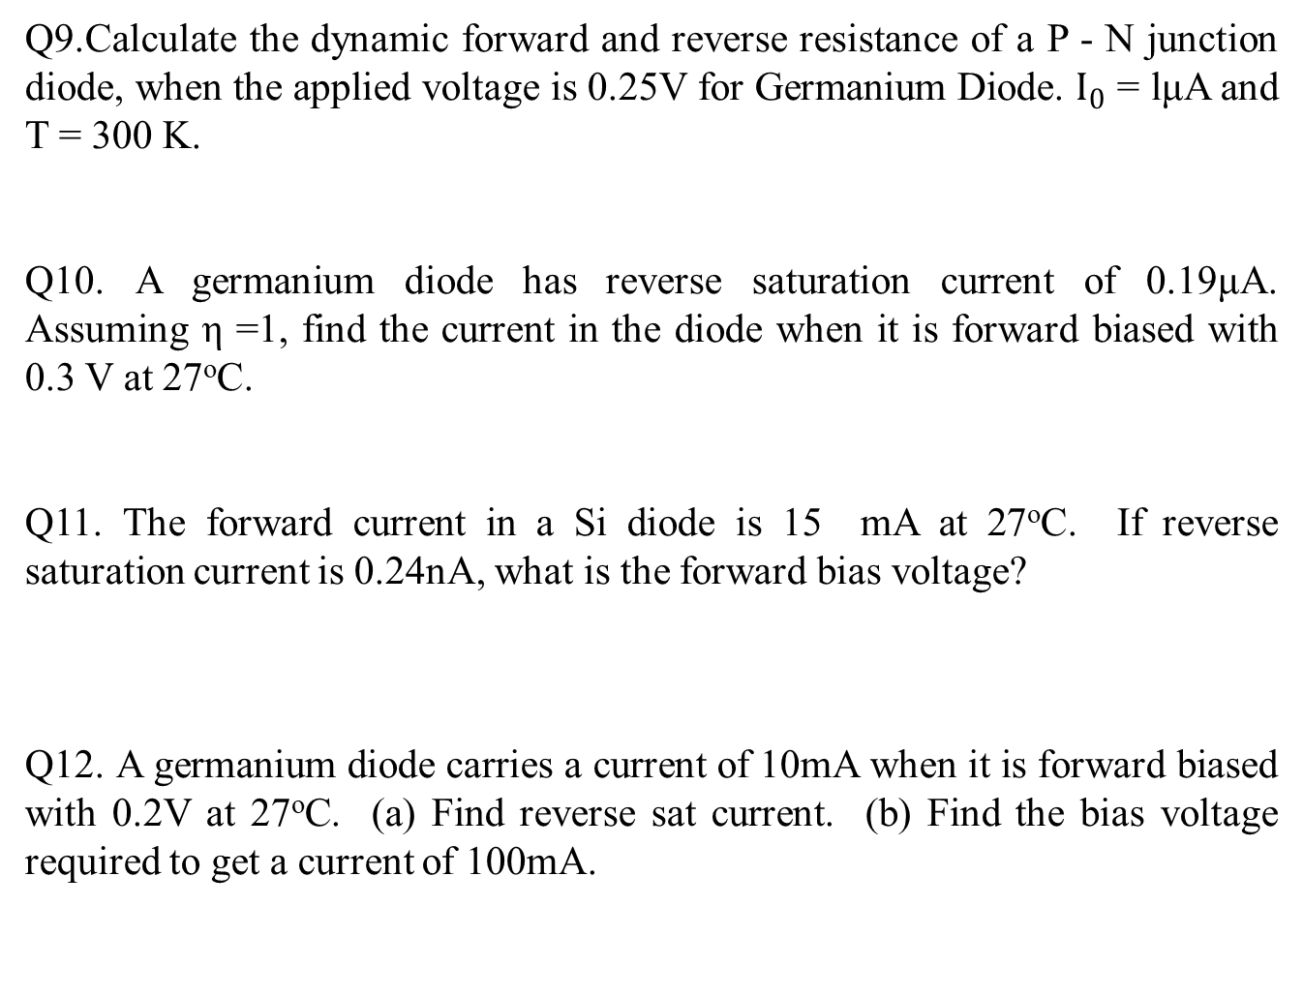
Exercises

Slide 58
Self test
1. The break-point voltage of Si diode is
a. 0.2V b. 0.7V c. 0.8V d. 1.0V
2. Why would you use silicon diodes instead of germanium diodes?

Slide 59
Self test
1. The arrow direction in the diode symbol indicates
a. Direction of electron flow.
b. Direction of hole flow (Direction of conventional current)
c. Opposite to the direction of hole flow
d. None of the above
2. When the diode is forward biased, it is equivalent to
a. An off switch b. An On switch
c. A high resistance d. None of the above
.

Slide 60
Self test
1. Explain the principle of PIN diode.
2.What is the difference between PN diode and Schottky diode.
3.Which type of diode exhibits negative resistance and why?
4. Which of the following is not an essential element of a dc power supply
a. Rectifier
b. Filter
c. Voltage regulator
d. Voltage amplifier

Slide 61
Self test
5. What is true about the breakdown voltage in a Zener diode?
a. It decreases when current increases.
b. It destroys the diode.
c. It equals the current times the resistance.
d. It is approximately constant
6. Which of these is the best description of a Zener diode?
a. It is a rectifier diode.
b. It is a constant voltage device.
c. It is a constant current device.
d. It works in the forward region.

Slide 62
Self test
1.Why silicon is preferred over germanium for semiconductor devices?
2.List different elemental and compound semiconductors.

